Slide 1
Module 6 : Evaluate

Slide 2
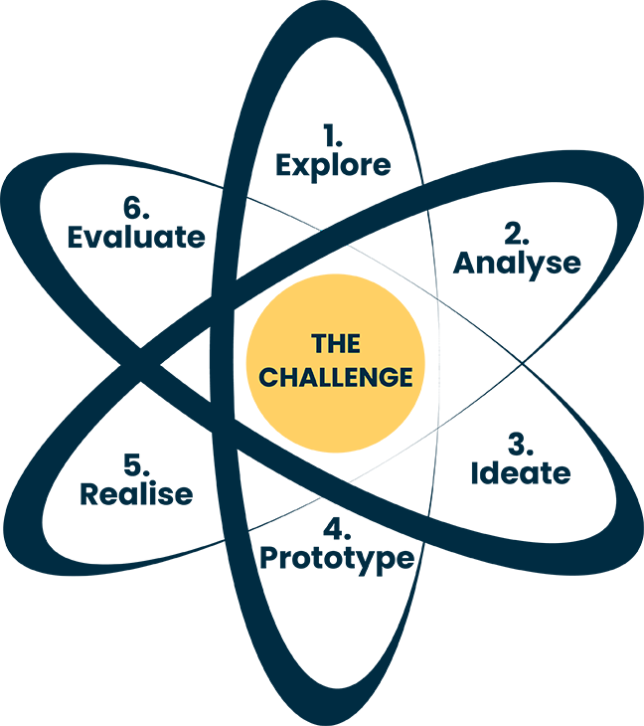
6. Evaluate
The last step is to evaluate, this phase is composed of two parts:
1) An external part where the idea and the action or action plans are evaluated by the external partners in the project.
2) An internal evaluation with the teachers and the other students of the innovative learning process.

Slide 3
Importance of Evaluation

Slide 4
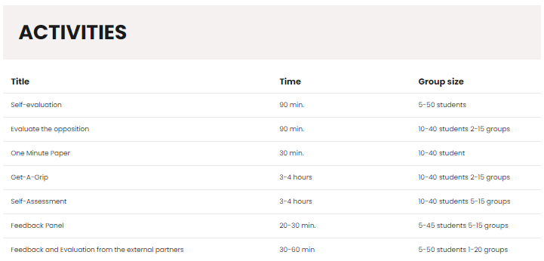
Activities for Evaluate

Slide 5
External Feedback
Input from external partners or stakeholders
Internal Feedback
Feedback from team members or within the organization.
Self-Assessment
Evaluation by individuals or teams involved.
One Minute Paper
Quick and concise feedback collection method.

